Slide 1
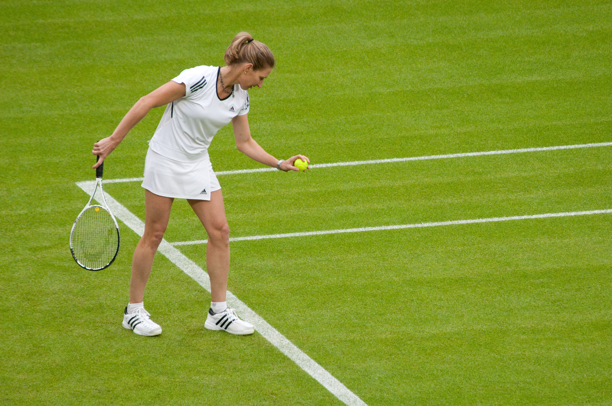
Question:
What is the person playing ?
Answer:
Tennis
Original Image
Regions that reveal the answer

